Slide 1
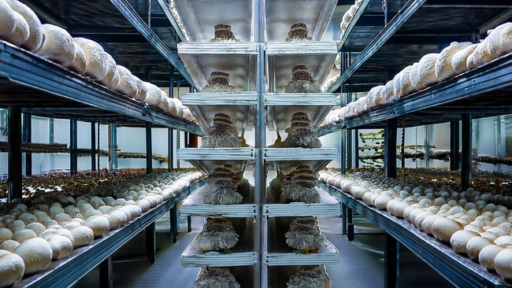
MUSHROOM MANDI
INVESTOR PITCH 2026
SEED ROUND
Mushroom
Mandi
India's Unified Mushroom Industry Operating System
IoT + ERP
Marketplace
AI Intelligence
₹2.50 Cr
22 Months
₹88 Cr
Seed Investment
To Market
Year 5 Revenue

Slide 2
PRESENTATION OVERVIEW
Executive Overview
01
The Opportunity
05
Product & Tech
India's mushroom market growing at 12.84% CAGR
IoT sensors, cloud platform, AI intelligence
02
The Problem
06
Government Support
Fragmented industry with 12-18% crop losses
40-50% subsidies, NABARD financing aligned
03
The Solution
07
Business Model
One platform connecting entire mushroom ecosystem
SaaS + Marketplace + Data monetization
04
Market Analysis
08
Investment Ask
₹960 Cr TAM with zero direct competition
₹2.50 Cr seed for ₹88 Cr Year 5 revenue

Slide 3
VISION
The Big Picture
EVOLUTION ROADMAP
1
Sensor Network
Year 1-2
50 farms, data collection begins
What is Mushroom Mandi?
2
Intelligence Layer
Year 2-3
Yield optimization algorithms, benchmarking
A comprehensive software + hardware platform that helps mushroom farmers monitor and automate growing operations using sensors, cloud computing, and mobile apps.
3
Marketplace Launch
B2B connect: farms ↔ suppliers ↔ consultants
Year 3-4
4
Ecosystem Dominance
Year 4-5
IoT Monitoring
10,000 stakeholders, financing, insurance, exports
Real-time sensors for temperature, humidity, CO2
Cloud Platform
Centralized data, analytics, and automation
Mobile Access
Progressive web app, works offline
TARGET BY YEAR 5
₹88 Cr
10,000+
Stakeholders Connected
Annual Revenue

Slide 4
MARKET OPPORTUNITY
India's Mushroom Economy
A High-Growth Market Ready for Disruption
Market Size 2025
Projected 2035
CAGR Growth
$1.58B
$5.29B
12.84%
USD Billion
USD Billion
Annual Growth
PRODUCTION STATISTICS
TOP PRODUCING STATES
Annual Production
487,000+ MT
1
Bihar
10.82%
Global Share
2%
28,000+ MT annually
2
Maharashtra
9.89%
Commercial Farms
1,000+
Button & Shiitake focus
Spawn Demand
8,000-10,000 MT
3
Odisha
9.0%+
Oyster & Cremini
4
Punjab
45K-48K MT
~400 producers
Key Driver: Rising health consciousness and demand for protein-rich, low-calorie foods is fueling 20% annual growth in India's healthy food sector, expected to reach $30 billion by 2026.

Slide 5
THE PROBLEM
Inefficiency Crisis
Indian Mushroom Farms Face Critical Challenges
12-18%
₹4-6L
Crop Loss to Contamination
Annual Waste per 100-Room Farm
Green mold (Trichoderma) causes up to 70% yield losses. Detection happens 7-10 days after infection starts—too late to save the batch.
Manual monitoring, delayed problem detection, and operational chaos cost each farm lakhs annually in lost productivity.
4 hrs
2-3 hrs
15-20%
20
Avg delay detecting problems
Daily manual data entry
Inventory discrepancy rate
Room scaling ceiling
ROOT CAUSE ANALYSIS
1
No Real-Time Data
2
Fragmented Tools
3
No Expert Access
Manual checks 3-4 times daily miss critical fluctuations
Excel, WhatsApp, paper logs—no central system
Crisis response takes days, not hours

Slide 6
COMPETITIVE LANDSCAPE
Zero Competition in India
No India-Focused Mushroom IoT Platforms Exist Today
OPTION 1: GENERIC IOT PLATFORMS
OPTION 2: INTERNATIONAL AG-TECH
Blynk
₹1,500-2,000/mo
FarmLogs
$5K-15K/year
ThingSpeak
Free tier limited
AgWorld
$10K-30K/year
AWS IoT Core
$5/1M messages
Granular
$50K+ enterprise
Limitations:
Limitations:
No mushroom-specific logic
US/EU focused, field crops only
Requires ₹3-5L custom dev
Too expensive (₹4-12L/year)
Fragmented tools, no integration
No HVAC control for mushrooms
OPTION 3: CUSTOM IN-HOUSE DEVELOPMENT
₹15-25L
12-18 mo
₹2-4L
Development Cost
Timeline
Annual Maintenance
Only viable for ₹50Cr+ corporate farms. Not accessible to 1,000+ small-medium farms.
OUR COMPETITIVE ADVANTAGE
Mushroom-Specific
2-4 Week Setup
₹50K-2L Year 1
Offline-First

Slide 7
THE SOLUTION
One Platform, Infinite Possibilities
From Chaos to Complete Control
IoT Sensors
ERP System
Marketplace
Temperature monitoring (±0.5°C)
Inventory management
Verified spawn suppliers
Humidity tracking (±2% RH)
Batch tracking (spawn→harvest)
Equipment vendors
CO2 levels (10-1000 ppm)
Worker time tracking
Expert consultants
Air quality sensors
Yield analytics
Escrow payments
Real-time alerts (<15 min)
Financial reporting
Group buying discounts
TRANSFORMATION IMPACT
12-18%
4 hrs
2-3 hrs
80-85%
→ <7%
→ <15 min
→ <30 min
→ >95%
Contamination Loss
Detection Time
Daily Data Entry
Inventory Accuracy
Net Savings: ₹2-3L annually per farm vs ₹50K-1L platform cost = 3-6x ROI

Slide 8
TECHNOLOGY
Edge-to-Cloud Intelligence
Built for Rural India: Offline-First, Cloud-Enabled
Edge Layer
Cloud Layer
Client Layer
On-Farm, Offline-First
AWS/GCP Centralized
Progressive Web App
• ESP32 (ESP32DA) direct-to-cloud
Phase 1-2 (0-100 farms)
• React 18 + TypeScript
• PostgreSQL 15 (Cloud) + Redis cache
Docker Compose on EC2
• Real-time dashboard
• Cloud-first, RPi offline buffer (Phase 2)
• SMS + Push alerts
• HTTP REST + JSON (Phase 1)
Phase 3 (100-200 farms)
• Works offline (Service Worker)
• Auto-sync every 30 seconds (target)
ECS Auto-Scaling
• No app store needed
Sensors: SCD4x (₹2,500), DHT11 (₹250), DS18B20 x10 (₹1,500), ESP32 (₹600)
Phase 4+ (200+ farms)
WebSocket: <1s live updates
Optional Kubernetes
PHASED INFRASTRUCTURE APPROACH
1
2
3
Months 1-12
Months 13-22
Month 19+
0-100 farms
100-200 farms
200+ farms
₹15-25K/mo
₹35-60K/mo
₹60-100K/mo
PostgreSQL 15
FastAPI (Python)
Row-Level Security
+ TimescaleDB
REST + WebSocket APIs
Multi-tenant isolation

Slide 9
PRODUCT FEATURES
From Monitoring to Intelligence
Complete Farm Management in Your Pocket
Real-Time Monitoring
Batch Tracking
Live temperature, humidity, and CO2 tracking with <15 minute alert response time. Dashboard shows all rooms at a glance.
Complete lifecycle from spawn to harvest. Track every batch's environmental conditions, inputs, and outcomes. FDA FSMA compliant.
Automated HVAC Control
Inventory Management
Smart rules: "IF temp >28°C THEN turn on fan." Manual override always available. Reduces labor by 50%+.
Track spawn, substrate, casing, and supplies. Auto-reorder alerts when stock <20%. Eliminate Excel spreadsheets.
Contamination Early Warning
Offline-First Mobile App
AI detects infection 3-5 days before visible signs. Pattern recognition from 1000+ contamination incidents.
PWA works without internet for weeks. Data syncs automatically when connection returns. Designed for rural India's connectivity challenges.
Yield Analytics & Benchmarking
15%
Compare your farm against regional leaders. Identify optimization opportunities.
Avg yield improvement

Slide 10
COMPETITIVE MOAT
The Data Flywheel
Network Effects That Compound Over Time
More Farms
More Data
Better AI
Higher Yields
More Farms
Each new farm makes the platform more valuable for everyone
DATA ASSETS ACCUMULATED
YIELD OPTIMIZATION ENGINE
Environmental Patterns
50M+ readings/year
Top 10% Farms Achieve
Yield Benchmarks
By region, season, strain
40%
Contamination Logs
1000+ batches
Higher yields than average
Cost Structures
Real profitability data
Best Practices
Top 10% farms
Knowledge Democratized
AI analyzes successful patterns and recommends optimizations to all farms
Defensibility: After 3 years of data, switching costs become prohibitively high. Competitors can't replicate the dataset.

Slide 11
ECOSYSTEM EXPANSION
Mushroom Mandi Marketplace
B2B Ecosystem: One-Stop Procurement Network
Spawn Labs
Substrate
Equipment
Packaging
Logistics
Verified suppliers, viability tests
Quality tested, delivery tracking
HVAC, shelving, demo units
Food-grade certified
Cold chain, temp tracking
VERIFICATION TIERS
KEY FEATURES
T1
Basic (Free)
Smart Sourcing: Auto-match suppliers within 200km
Business registration, address verification
Group Buying: Small farms pool orders for 15% discount
T2
Verified (₹5K/year)
Escrow Payments: Released after delivery + quality check
Quality certification, 3 references, 6mo history
T3
Premium (₹15K/year)
Credit Terms: 30-60 days for verified farms
On-site audit, batch tracking, "Platform Guaranteed"
Equipment Financing
₹200 Cr
"Try Before Buy" program + EMI facilitation
Year 5 Marketplace GMV

Slide 12
KNOWLEDGE ECONOMY
Consultancy Network
Democratizing Expertise Across India
Plant Setup
Production
Disease Expert
Business
Infrastructure design, licensing, initial training
Strain selection, troubleshooting, optimization
Contamination control, biosecurity
Financial planning, marketing, scaling
₹3K-8K/visit
₹5K-10K/hour
₹50K-2L/project
₹2K-5K/hour
BADGE SYSTEM
CONSULTATION MODES
Bronze (Verified)
Remote Video (Immediate)
5+ years experience, 3 references, background check
2-hour response guarantee. AI triage matches best expert.
Silver (Proven)
10+ consultations, 4.5★ rating, 90%+ satisfaction
Plant Setup Project
Gold (Leader)
Milestone-based payments. IoT monitors progress.
50+ consultations, 4.8★ rating, specialization cert
Retainer Support
₹25K/month for virtual farm manager package.
Impact: New farmers get expert guidance. Running farms access troubleshooting in hours, not days. Consultants build careers on the platform.

Slide 13
POLICY ALIGNMENT
Government Support
Aligned with National Agricultural Priorities
MIDH
NABARD
Mission for Integrated Development of Horticulture
National Bank for Agriculture
Mushroom Production Unit
40-50%
Priority Sector Loans
Up to ₹30L/unit subsidy
₹5L - ₹2Cr for agri-entrepreneurs
Spawn Making Unit
40-50%
Interest Subvention
Up to ₹20L/unit subsidy
3-4% reduced interest rates
Small Scale Unit
50%
Repayment Terms
₹2L/unit for 200 sqft structure
5-7 year flexible repayment
STATE-SPECIFIC PROGRAMS
Punjab
Maharashtra
Haryana
Uttar Pradesh
50%
40-50%
50%
₹32/sqft
Shed subsidy + free KVK training
MIDH subsidy + spawn support
Structure subsidy + HAFED marketing
Max 1000 sqft per beneficiary
Application Process: Prepare DPR → Submit to District Horticulture Officer → Technical verification → Approval (30-60 days) → Implementation

Slide 14
NATIONAL PRIORITIES
Atmanirbhar Bharat Vision
Aligned with India's Self-Reliance Mission
Doubling Farmer Incomes
Reducing Post-Harvest Losses
Platform enables 20-30% yield improvement and 5-10% cost reduction, directly contributing to PM's vision of doubling farmer incomes by 2025.
Contamination reduction from 12-18% to <7% aligns with national goal of 30% post-harvest loss reduction. Saves ₹150 Cr+ annually at scale.
₹9.2L annual benefit
30% target reduction
For 20-room farm by Year 3
National food security goal
Agri-Tech Adoption
FPO Support
Rural Employment
Promotes IoT, AI, and precision farming in line with Digital India mission
Enables Farmer Producer Organizations to scale with technology and market linkages
Creates 10,000+ jobs in mushroom farming and reduces rural-urban migration
EXPORT READINESS & COMPLIANCE
FSSAI Compliance
FDA FSMA Ready
Platform enables batch traceability for food safety standards
Immutable records for export to US/EU markets

Slide 15
MARKET SEGMENTATION
Target Market
1,000+ Commercial Farms Across India
Small Farms
Medium Farms
Large Farms
2-10 rooms
10-30 rooms
30+ rooms
Count
~500
Count
~400
Count
~100
ARPU/Year
₹2.4L
ARPU/Year
₹12L
ARPU/Year
₹36L
TAM
₹120 Cr
TAM
₹480 Cr
TAM
₹360 Cr
TOTAL ADDRESSABLE MARKET
Addressable (Phase 1-3)
₹960 Cr
₹200-300 Cr
20-30% of TAM
CUSTOMER PERSONA
GEOGRAPHIC FOCUS
Rajesh Kumar, 42
Punjab
Haryana
Ludhiana, Punjab | 25 rooms | Button mushrooms
Maharashtra
Himachal Pradesh
Pain: Lost ₹80K to contamination. Spends 4-5 hrs daily monitoring. Wants to scale to 50 rooms.
Willing to pay: ₹2-5K/room/month
Karnataka
Uttar Pradesh

Slide 16
REVENUE MODEL
Multiple Revenue Streams
Diversified, Recurring, Scalable
SaaS Subscriptions
Hardware Sales
Marketplace
Basic
₹2K/room
Per-Farm Kit
Transaction Fees
2-3%
Monitoring only
₹6,700
On GMV
Pro
₹4K/room
ESP32 + SCD4x + DHT11 + DS18B20 x10 + LCD + Relays
Listing Fees
₹5-15K
+ Automation + Inventory
Annual verification
Enterprise
₹3K/room
Margin
Premium Listings
₹15-50K
Full ERP + AI (scale)
₹4,600
Featured suppliers
18% gross margin per kit
PHASE 3-5 REVENUE EXPANSION
REVENUE BY PHASE
Consultancy Commission
15-20%
Phase 1-2 (SaaS only)
₹9.12 Cr
Equipment Financing
1% origination
Phase 3 (+Marketplace)
₹34.1 Cr
Data Licensing
Annual licenses
Phase 4-5 (Ecosystem)
₹87.9 Cr
Crop Insurance
5% premium
Take Rate: 4.5% average across all revenue streams by Year 5

Slide 17
UNIT ECONOMICS
Profitable at Scale
Strong Unit Economics Drive Sustainable Growth
REVENUE (PRO TIER)
COSTS (PER FARM/YEAR)
Average farm size
15 rooms
Cloud infrastructure
₹1,200
Monthly revenue
₹60,000
Support (10%)
₹7,200
Annual revenue
₹7.2L
Gross Margin
88%
₹6.35L profit
₹40K
₹19.05L
47x
30
Customer Acquisition Cost
Lifetime Value (3 years)
LTV/CAC Ratio
Farms to Break-Even
BREAK-EVEN ANALYSIS
Month 12-15
18 mo
Fixed costs: ₹1.92 Cr development
Payback period
Gross margin per farm: ₹6.35L/year
Target Metrics: <12% annual churn, >40 NPS, 99.5% platform uptime

Slide 18
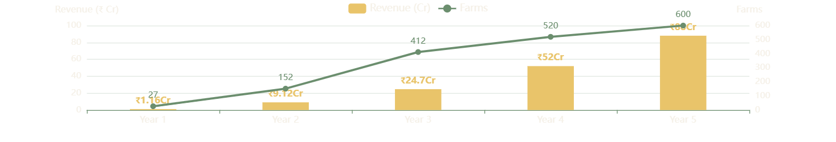
FINANCIAL PROJECTIONS
3-Year Roadmap
From ₹1.16 Cr to ₹24.7 Cr ARR
Y1
Y2
Y3
Foundation
Growth
Scale
₹1.16 Cr
₹9.12 Cr
₹24.7 Cr
ARR
ARR
ARR
27 farms
152 farms
412 farms
Pilot + Beta + Commercial
5.6x growth
2.7x growth
YEAR 5 ECOSYSTEM VISION
600 farms | 800 suppliers
₹88 Cr
₹200 Cr marketplace GMV
Total Revenue
82% gross margin | 28% EBITDA

Slide 19
COMPETITIVE MOAT
Why We Win
Defensibility That Deepens Over Time
First-Mover Advantage
Data Network Effects
Zero direct competition in India. 2-year head start to build data network effects and customer relationships.
Yield benchmarks no one else has. 50M+ sensor readings power AI recommendations that improve with each farm.
Deep Domain Expertise
High Switching Costs
Mushroom-specific logic, not generic ag-tech. Understand spawn run, pinning, contamination patterns.
3 years of farm data, integrated ERP, established supplier relationships. Farms won't switch easily.
Offline-First Design
Ecosystem Lock-In
Built for rural India's connectivity challenges. Works for weeks without internet. Competitors can't easily replicate.
Marketplace + Consultancy + Financing create multiple touchpoints. Value increases with each new connection.
MOAT DEEPENING OVER TIME
Y1
Y2
Y3
Y5
Product Moat
Data Moat
Network Moat
Standard Moat
Best IoT features
Yield benchmarks
Marketplace liquidity
Industry standard

Slide 20
EXECUTION PLAN
Implementation Roadmap
22 Months to Market Leadership
1
Phase 1
2
Phase 2
3
Phase 3
Months 1-7.5
Months 8-15
Months 16-22
Core IoT Monitoring
HVAC Control + Mobile
ERP Modules
Database schema (11 core tables + RLS)
Modbus gateway for HVAC
Inventory management
Sensor integration (SCD4x, DHT11, DS18B20 x10)
Automation rules engine
Batch tracking (spawn→harvest)
Dashboard + alerts
PWA mobile optimization
Worker time tracking
1 pilot farm (Month 4)
5 beta farms (Month 11)
20 paying farms (Month 22)
Field debugging buffer
Hardware integration buffer
UAT and documentation
Goal: 99.5% uptime, <15min alerts
Goal: 50%+ time savings
Goal: ₹1.16 Cr ARR
KEY MILESTONES
Month 4
Month 11
Month 22
Month 24
Pilot farm live
5 beta farms
Commercial launch
Series A ready

Slide 21
RISK MANAGEMENT
Risk Mitigation
Addressing Key Challenges Proactively
IoT Hardware Reliability
High Customer Acquisition Cost
Sensors fail (2-3 year lifespan), edge device crashes
Sales cycle >6 months, CAC exceeds ₹1L
Mitigation:
Mitigation:
• Sensor redundancy (2 per room)
• Freemium model (1 room free)
• Auto-detect failures
• Case study testimonials
• 24hr replacement shipping
• Referral program (₹10K credit)
Network Connectivity
High Churn Rate
Rural farms have poor 4G, frequent outages
Farms cancel after 3-6 months if ROI not proven
Mitigation:
Mitigation:
• 30-day local storage
• Onboarding checklist
• Auto-retry sync queue
• Quarterly ROI reviews
• Cellular + WiFi fallback
• Annual contracts (20% discount)
ADDITIONAL RISKS & MITIGATIONS
Database Scaling
Team Retention
Market Timing
TimescaleDB compression, archival policy, sharding plan ready
Competitive salaries, ESOP pool, documentation culture
First-mover advantage, deep domain expertise, high switching costs

Slide 22
KPIS & MEASUREMENT
Success Metrics
Measuring Impact at Every Level
NORTH STAR METRIC
50%+
Contamination Reduction
From 12-18% to <7% within 6 months of onboarding
Loss Reduction
FARM-LEVEL METRICS
PLATFORM-LEVEL METRICS
Contamination Loss
12-18%
<7%
Platform Uptime
99.5%
Detection Time
4 hrs
<15 min
SLA guarantee
Data Entry Time
2-3 hrs
<30 min
Customer NPS
>40
Inventory Accuracy
80-85%
>95%
Quarterly surveys
Yield Improvement
Baseline
+15%
Churn Rate
<12%
Annual target
Daily Active Users
60%+
Of onboarded farms
₹2-3L
3-6x
₹150Cr+
Net Savings/Farm/Year
ROI for Farms
Industry Savings at Scale

Slide 23
VISION 2026-2030
Future Roadmap
From Platform to Ecosystem Dominance
4
Phase 4
5
Phase 5
6
Phase 6
Months 23-30
Months 31-42
Years 5-6
Data Intelligence
Full Ecosystem
Industry Dominance
Yield prediction AI
Consultancy platform (100+)
Export certification
Contamination early warning
Marketplace scale (500+)
Research partnerships
Anomaly detection
Equipment financing
Input manufacturing
Benchmarking platform
Working capital loans
International expansion
Supplier directory (200+)
Crop insurance
Policy influence
150 farms | ₹50L GMV pilot
400 farms | ₹20 Cr GMV
600 farms | ₹200 Cr GMV
INTERNATIONAL EXPANSION TARGETS
Bangladesh
Nepal
Sri Lanka
More
Similar climate
Himalayan region
South Asian market
SEA, Africa

Slide 24
ARTIFICIAL INTELLIGENCE
AI/ML Capabilities
The Intelligence Layer
Yield Predictor
Anomaly Detector
Forecast harvest 14 days early
Flag unusual patterns in real-time
±8% accuracy
21 days input
90% recall
Real-time stream
Contamination Early Warning
Cost Optimizer
Detect infection 3-5 days before visible
Minimize input costs without yield loss
85% precision
Air quality + temp
5-10% savings
Substrate mix
Optimal Parameter Recommender
Benchmarking System
Suggest ideal settings based on top 10% farms
Compare against regional leaders
Location-aware
Season-aware
Percentile ranking
Best practice lib
ML INFRASTRUCTURE
Data Lake
Training
Deployment
Monitoring
S3/Athena/Redshift
SageMaker/Vertex AI
API endpoints <100ms
Drift detection

Slide 25
BUILDING FOR SUCCESS
Team & Execution
The Right Team to Execute the Vision
CORE TEAM (22 MONTHS)
DEVELOPMENT COST BREAKDOWN
2 Full-Stack Engineers
Team Salaries
₹1.19 Cr
React, FastAPI, TypeScript
Benefits (18%)
₹21.4L
₹1.2-1.5L/month each
1 IoT Specialist
Office Space
₹11L
Raspberry Pi, Sensors, MQTT
Recruiting
₹8L
₹1.3-1.6L/month
1 DevOps Engineer
Equipment
₹4L
AWS, Docker, CI/CD
₹1.4-1.7L/month
Subtotal
₹1.43 Cr
Infrastructure
Third-Party
Hardware
Contingency
₹9.08L
₹4.18L
₹5.3L
₹30.4L
22 months
Stripe, Twilio, etc.
27 farm kits
20% buffer
REVISED TOTAL INVESTMENT
Recommended Funding
₹1.92 Cr
₹2.50 Cr
22 months fully-loaded
Includes safety margin

Slide 26
INVESTMENT OPPORTUNITY
Investment Ask
₹2.50 Crore Seed Round
FUNDING BREAKDOWN
Development
₹1.43 Cr (57%)
Working Capital
₹59L (24%)
₹2.50 Cr
Contingency
₹30L (12%)
Seed Round
Infrastructure
₹9L (4%)
Use of Funds
₹5L (2%)
Build core IoT + ERP platform
Hardware
Target
50 farms by Month 22
Goal
Prove product-market fit
FUTURE FUNDING ROUNDS
Series A
Series B
Series C
₹4 Cr
₹8 Cr
₹15 Cr
Month 18
Month 36
Month 54
200 farms, ₹2 Cr GMV
500 farms, ₹20 Cr GMV
International expansion

Slide 27
INVESTOR RETURNS
ROI for Investors
The Path to ₹88 Cr and Beyond
Year 3 Revenue
Year 5 Revenue
Profitability
₹24.7 Cr
₹88 Cr
28%
ARR from 412 farms
Ecosystem monetization
EBITDA margin
KEY METRICS BY YEAR 5
EXIT OPPORTUNITIES
Active Farms
600
Strategic Acquisition
Suppliers on Platform
800
Ag-tech giants, food companies
Monthly GMV
₹16.7 Cr
Annual GMV
₹200 Cr
IPO Potential
Year 7-8 with ₹100 Cr+ revenue
Take Rate (avg)
4.5%
Gross Margin
82%
Private Equity
Growth capital for expansion
TOTAL VALUE CREATED
Platform Revenue
₹435 Cr
₹88 Cr
Annual by Year 5
20% value capture

Slide 28
SOCIAL RESPONSIBILITY
Social Impact
Transforming Rural India
Reducing Contamination Losses
Improving Food Security
30% national reduction saves ₹150 Cr+ annually
Better yields contribute to protein-rich food availability
Creating Jobs
Reducing Migration
10,000+ jobs in mushroom farming ecosystem
Profitable local livelihoods keep families in rural areas
Enabling Entrepreneurs
Knowledge Transfer
500+ new farm entrepreneurs with platform guidance
Democratizing best practices from top 10% farms
SUSTAINABLE DEVELOPMENT GOALS
1
2
8
9
12
No Poverty
Zero Hunger
Decent Work
Industry & Innovation
Responsible Consumption

Slide 29
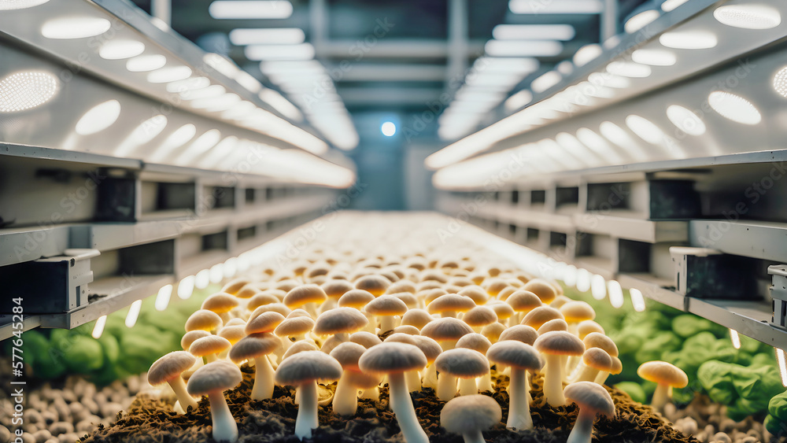
THE VISION
India's Mushroom Operating System
By 2030: 80% of India's Commercial Mushroom Production
New Entrepreneurs
Consultants
Start with platform guidance, feasibility calculators, and verified consultant directory
Build careers on platform, serve 10 farms/day remotely, 100% payment guarantee
Banks & Lenders
Running Farms
Lend based on platform data, cash-flow visibility reduces risk, enables formal credit
Optimize with AI recommendations, benchmark against leaders, automate operations
Industry Standard
Suppliers
Platform certification becomes quality benchmark for exports and domestic sales
Sell through verified marketplace, access 1000+ farms, reduce sales costs by 60%
The Ultimate Goal
80%
Become the operating system for Indian mushroom agriculture
Market penetration

Slide 30

Join Us in Building
the Future
Mushroom Mandi is not just software—it's the foundation for India's mushroom revolution
Zero Competition
Govt Support
Proven Tech
First-mover in ₹960 Cr market
40-50% subsidies aligned
IoT + AI + Marketplace
Let's transform 1,000+ farms and create a ₹100 Cr+ revenue business together
₹2.50 Cr
₹88 Cr
47x
Seed Investment
Year 5 Revenue
LTV/CAC
Contact us to discuss investment opportunities
investors@mushroommandi.com
+91 XXXXX XXXXX

